Slide 1
Introduction to Medical Sociology
Splash Spring 2022
Deb Haimowitz

Slide 2
TABLE OF CONTENTS
1.
INITIAL DISCUSSION
2.
CURRENT SNAPSHOT
3.
KEY TERMS
4.
DISCUSSION QUESTIONS
How do we define health? Illness? Why should we care?
What are the current important issues? In medicine and in public health.
What are the sociological terms? How do they relate to real life?
What are the main takeaways? How should we use this information to empower ourselves and others?

Slide 3
A Bit About Me!
I am a current Junior majoring in Health, Science and Social Policy (HSSP).
My current focus is reproductive and infertility healthcare access and medical sociology.
Email: dhaimowitz@brandeis.edu

Slide 4
Content Notes
Frequent mentioning of sickness, health, death, gender and race.
This presentation will not be addressing COVID-19
Health goes far beyond what we are experiencing in this present moment, and there are problems in this country and around the world that are not discussed enough.

Slide 5
Credit Where Credit is Due!
This class is heavily inspired by these classes:
SOC84A – Health, Community, and Society - Professor Siri Suh
SOC133B – Sociology of Reproduction – Professor Siri Suh
HSSP135A –Special Topics in Public Health: U.S. History and Policy – Professor Sarah Elisabeth Curi, JD, MPH

Slide 6
1.
Initial Discussion
How do we define health? Illness? Medicine? Why should we care?

Slide 7
Health Definitions Around the World
What are some noticeable differences in these answers?
Notes:
https://www.youtube.com/watch?v=geX1V1Q1BHY

Slide 8
“Health is a state of complete physical, mental, and social well-being and not merely the absence of disease or infirmity.”
– 1946, World Health Organization
Is this attainable?

Slide 9
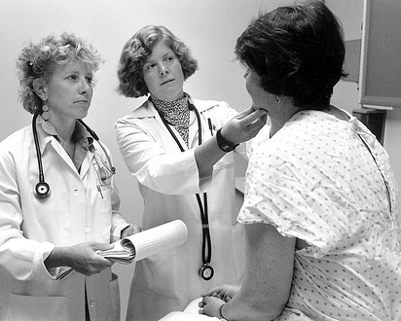
Illness and Medicine Concepts
Medical Gaze (Foucault): The inspection, examination, and analysis of the human body. Professional authority to doctors.
Sick Role (Parsons): Detailing the societal expectations and rights of the ill.
Exempt from normal social responsibilities
Cannot get well by an act of decision or will
Is obligates to get well
Must seek competent help
Now with these terms in mind, why is it important for sociologists to care about medicine?
Notes:
Birth of the Clinic by Michel Foucault
The Sick Role Revisited by Talcott Parsons

Slide 10
AMERICAN MEDICAL PROFESSION OVER TIME
Personalized Medicine
Patient Consultation
Regulation of Treatment
Apprenticeships.
Reliance on patient description to assess illness.
Religious Stigma.
Lesser patient confidence.
1847: Founding of American Medical Association to maintain “their honor and respectability”
1861: Germ Theory
2010s: PCP Shortage
2012: CRISPR ”cut and paste tool”
2013: FDA bans 23andMe
5th Century BC
17th Century
18th Century
19TH Century
20th Century
21st Century
Hippocrates
Institutions
Specialization
US’s first:
Hospital: 1752
Med School: 1765
By 1775:
3500 physicians in the US with ONLY 400 with a med degree
“Father of Modern Medicine”
Alongside philosophy and theology.
4 humors of health.
1933: American Board of Medical Specialties
1928: Alexander Fleming discovers penicillin
Height of Antibiotic Use
1930s-70s: Tuskegee Syphilis Study
How might these changes affect American society as a whole?
Notes:
What is Medicalization? by Madison Marcus, Emily Gold, and Alitza Shutt https://haenfler.sites.grinnell.edu/subcultural-theory-and-theorists/medicalization/
The Medical Profession Through History by Brian Dolan https://escholarship.org/uc/item/04w903fh

Slide 11
2.
Current Snapshot
What are the current important issues?
In medicine? In public health?

Slide 12
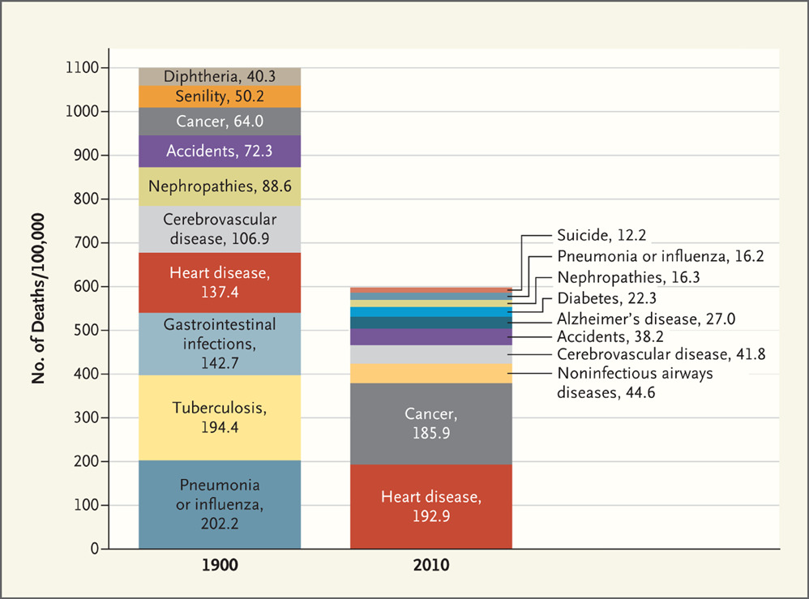
Sickness Throughout History
How does stigma factor into this timeline?
What kind of medical stigma existed then? Now?

Slide 13
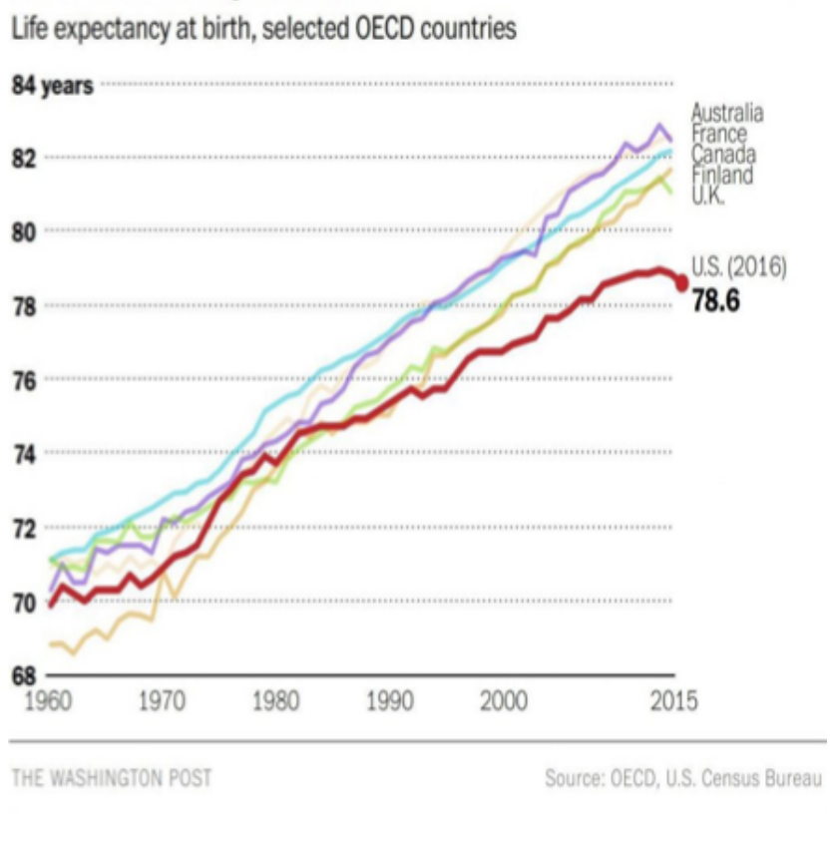
Life Expectancy (Global North vs South)
What trends do you notice? Why might that be?

Slide 14
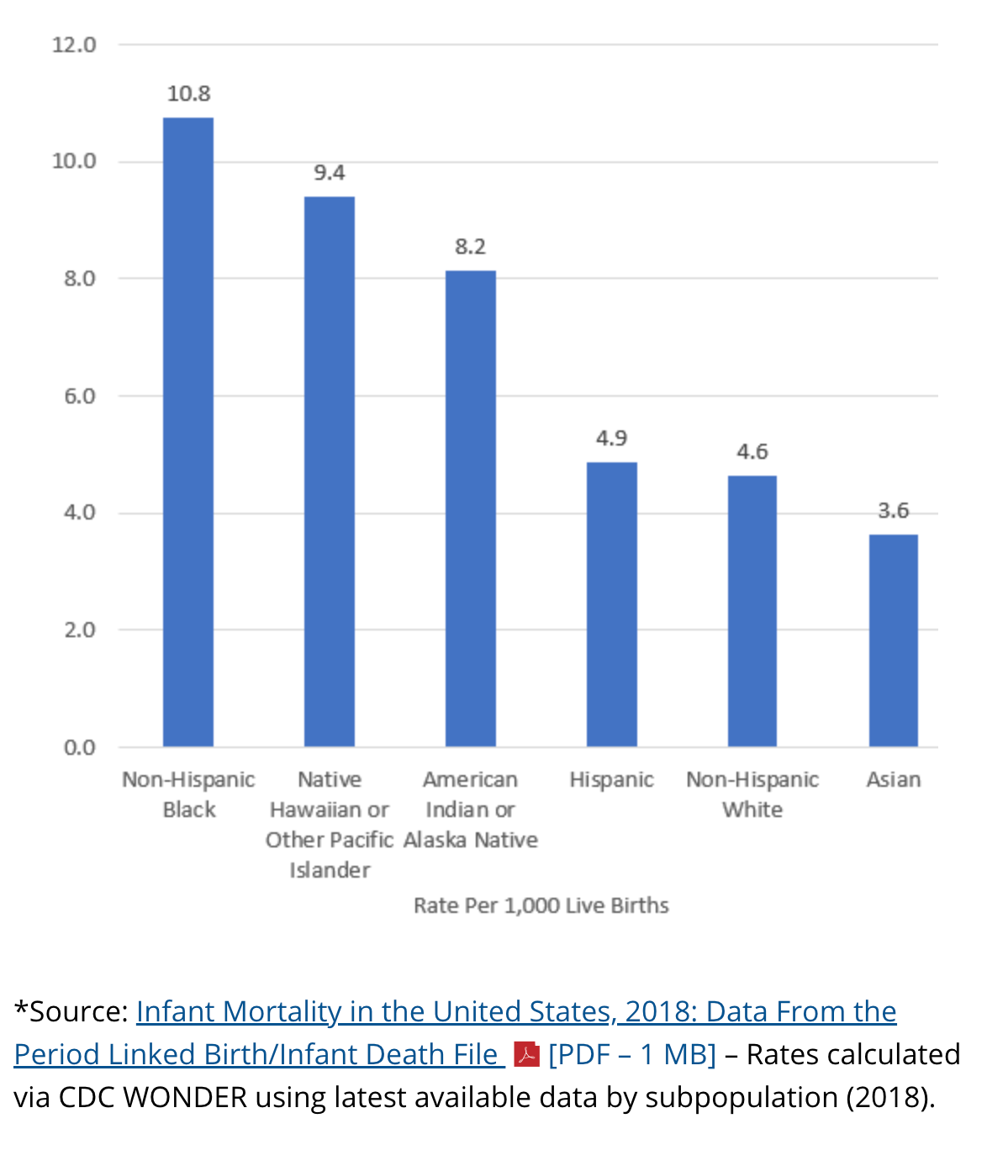
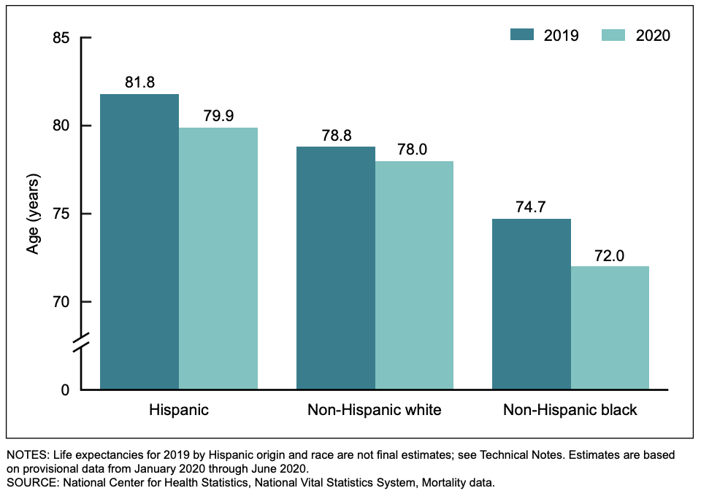
Racial Disparities in the United States
Why might life expectancy be so much lower in just a one year difference?

Slide 15
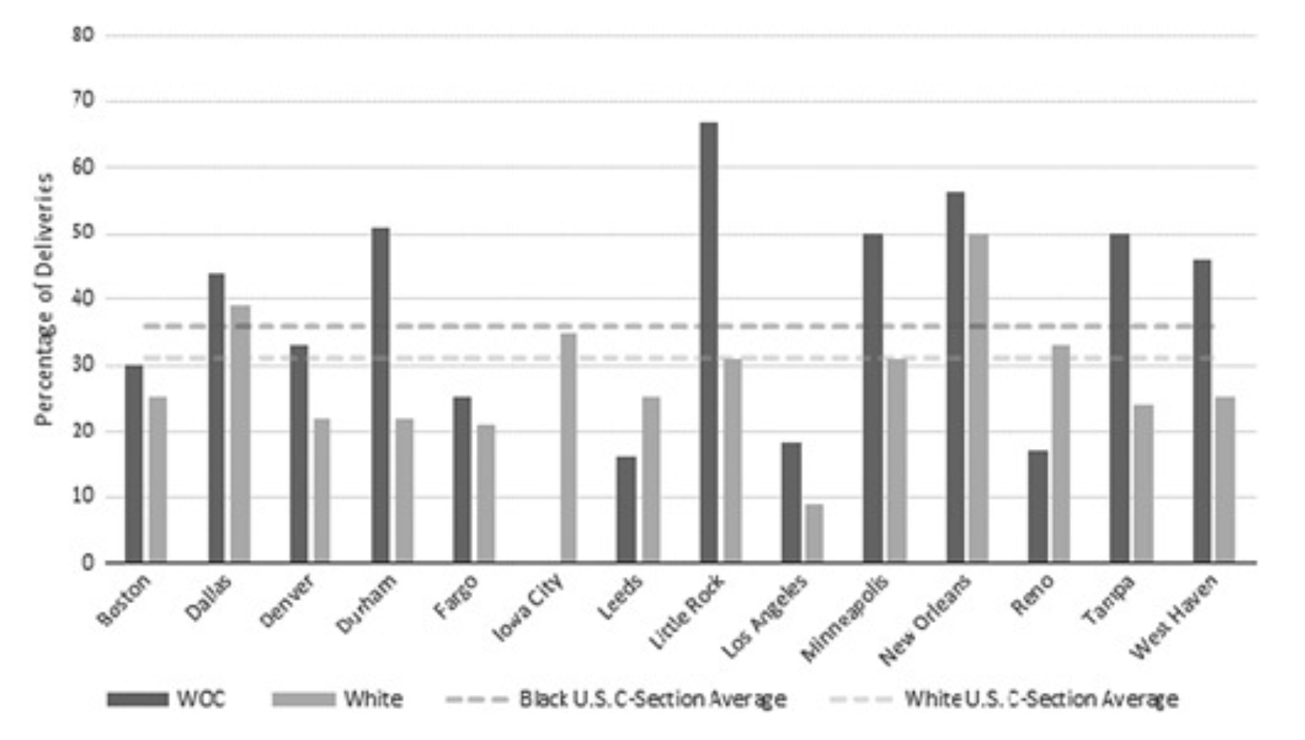
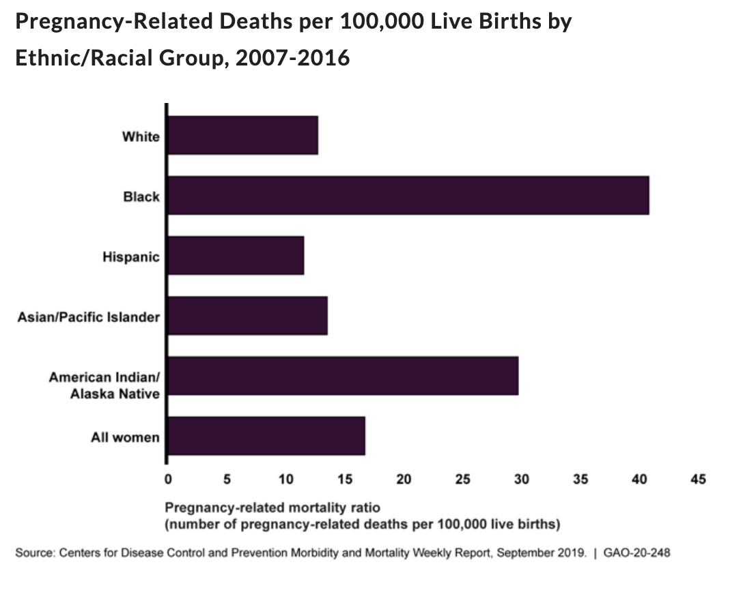
Racial Inequalities – Maternal Case Study
Source
Racial Differences in the Cesarean Section Rates Among Women Veterans Using Department of Veterans Affairs Community Care
Medical Care59(2):131-138, February 2021.
Since 1985, the WHO has considered the ideal rate for C-section births to be 10% to 15%. The CDC, as of 2018, reports more than 31% of births are via C-sections.

Slide 16
Conceptual Questions
How is the “ideal rate” decided? Why is it bad that the US is above this rate?
Why is the rate of c-sections highest in women of color?
What are the ways that disparities in health are created?
Social ways?
Medical ways?

Slide 17
3.
Key Terms
What are the sociological terms?
How do they relate to real life?
How are they perpetuated?

Slide 18
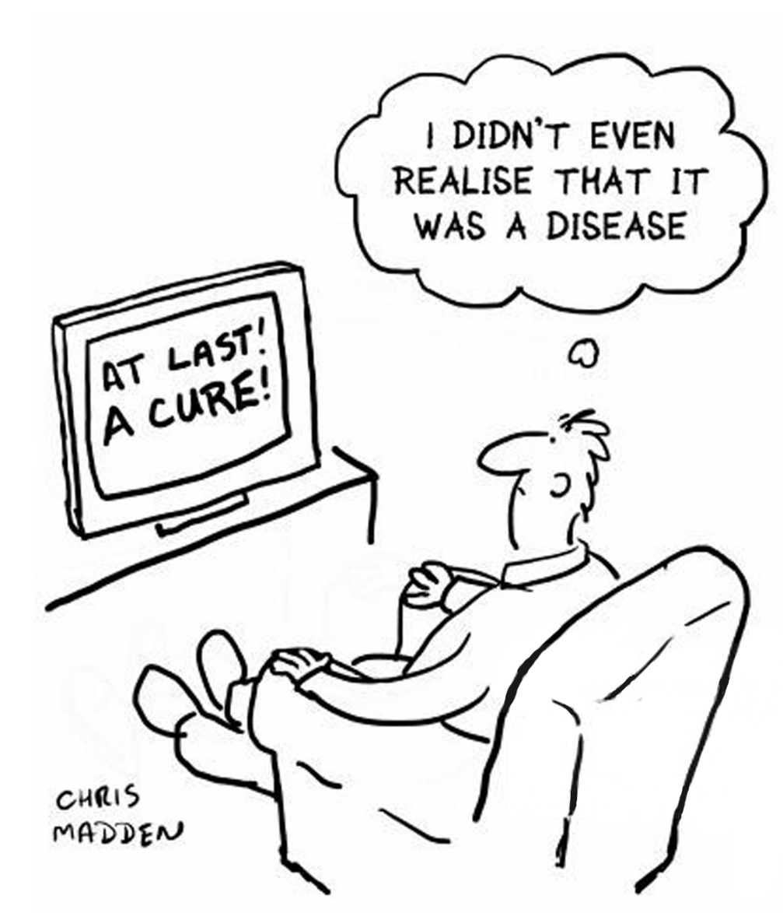
Medicalization (Conrad)
“A process whereby more and more of everyday life has come under medical dominion, influence and supervision”
When medicine is used to understand a problem.
How is it perpetuated?
Professionalization of medicine
Rise of scientific thinking over religion
Insurance and development of treatment
Not unidirectional
Examples
Childbirth - ADHD
Homosexuality - Aging
Notes:
The Medicalization of Society: On the Transformation of Human Conditions Into Treatable Disorders by Peter Conrad

Slide 19
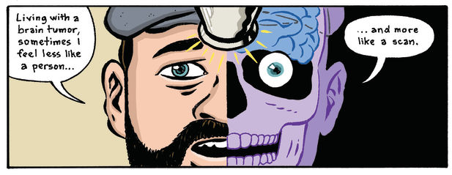
Biomedicalization (Clarke et al)
“Expansion through technoscientific transformations of biomedical organizations, infrastructures, knowledge and clinical treatments.”
Jurisdiction over life itself!
How is it perpetuated?
Integration of Computers to Health
Molecularization/Geneticization
Standardization of Medical Care
Examples
- HeLa Cells - Patient Information Collection
- Human Genome - Assisted Reproductive Technologies
Notes:
Biomedicalization: Technoscientific Transformations of Health, Illness, and U.S. Biomedicine by Clarke et al

Slide 20
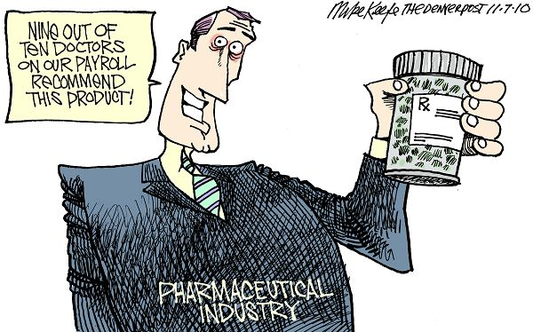
Pharmaceuticalization (Abraham)
“The process by which social, behavioral or bodily conditions are treated or deemed to need treatment, with medical drugs by doctors or patients”
Increased use of pharmaceuticals.
How is it perpetuated?
Integration of Computers to Health
Molecularization/Geneticization
Standardization of Medical Care
Examples (Good and Bad)
- AIDS Activism of FDA - BiDil
- “Lifestyle Drugs” like Viagra
Notes:
Pharmaceuticalization of Society in Context: Theoretical, Empirical and Health Dimensions by John Abraham

Slide 21
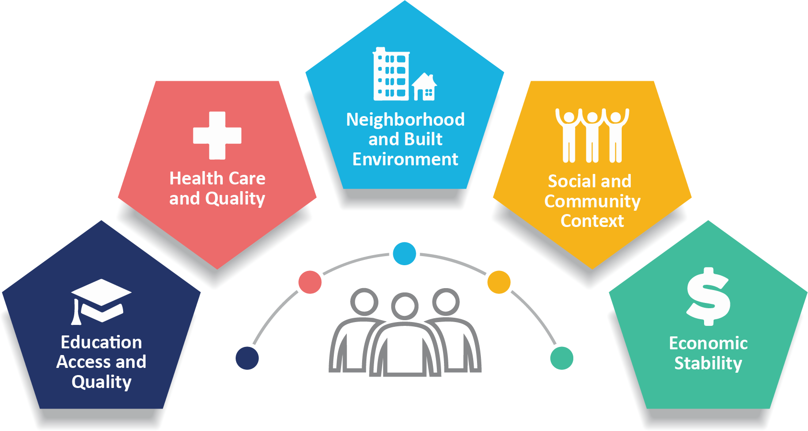
Social Determinants of Health
“the conditions in the environments where people are born, live, learn, work, play, worship, and age that affect a wide range of health, functioning, and quality-of-life outcomes and risks.” – Health.gov
How do these explain health inequalities?
Chronic Stress: Epigenetics
Exposure to Environmental Threats
Infrastructural racism
Examples:
- Flint, MI
- Exclusion in clinical trials
- Tobacco Ad Targeting
- Food Deserts
- Asbestos-Free Regulations

Slide 22
4.
Discussion Questions
What are the main takeaways?
How should we use this information to empower ourselves and others?

Slide 23
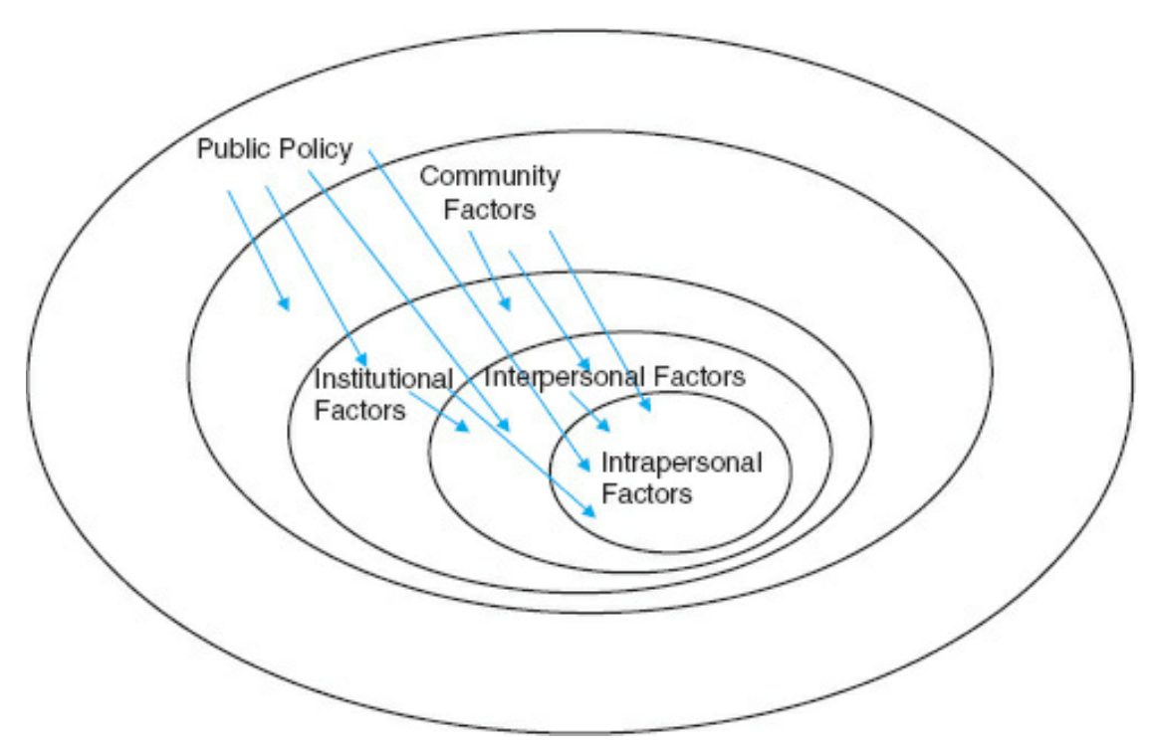
The Ultimate Goal? Empowerment!
Notes:
“An ecological perspective on health promotion programs” by McLeroy, Bideau and Glanz

Slide 24
Extra Material
“The trauma of systematic racism is killing Black women. A first step toward change...” – T. Morgan Dixon and Vanessa Garrison Ted Talk (2017)
David R. Williams: How racism makes us sick | TED Talk (2016)
“The decline of midwives and the rise of medical obstetricians.” - Wertz and Wertz (2001)
“Your ZIP Code Might Determine How Long You Live—and the Difference Could Be Decades” – Ducharme and Wolfson (2019)
”Getting Better: 200 Years of Medicine” – NEJM Group (2012)

Slide 25
THANKS!
Do you have any questions?
dhaimowitz@brandeis.edu
Please keep this slide for attribution

